Slide 1
Chronic coronary syndrome
Dr. Nijin Jose
Chair: Dr. Sajeer K T
4.4.2023

Slide 2
References
Braunwald’s Heart disease, a textbook of cardiovascular medicine, 12th edi
Fuster and Hurst’s the Heart, 15th edi
2019 ESC guidelines for diagnosis and management of chronic coronary syndromes

Slide 3
a dynamic process of ---
atherosclerotic plaque accumulation and
functional alterations of coronary circulation
that can be modified by lifestyle, pharmacological therapies, and revascularization,
which result in disease stabilization or regression.³

Slide 4
Includes
Chronic stable angina
Asymptomatic ischemia
Prior myocardial infarction
Prior coronary revascularization
Non obstructing coronary atherosclerosis—microvascular disease

Slide 5
Spectrum of chronic coronary syndrome
6 clinical scenarios→
Patients with suspected CAD and stable anginal symptoms and / or dysponea
Patients with new onset of HF or LV dysfunction and suspected CAD
Asymptomatic or symptomatic patients with stabilized symptoms <1 yr after an ACS or patients with recent revascularization
Asymptomatic and symptomatic patients >1yr after initial diagnosis or revascularization
Patients with angina and suspected vasospastic or microvascular disease
Asymptomatic subjects in whom CAD is detected at screening

Slide 6
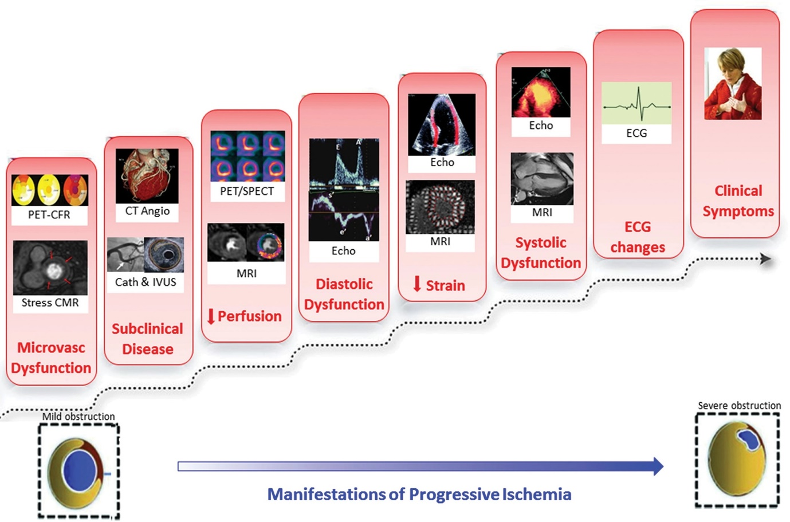
Pathophysiology

Slide 7
 | Increased oxygen demand | Decreased oxygen supply
Non cardiac causes | Thyroid dysfunction Sympathomimetic toxicity (cocaine) Hypertension Anxiety Arteriovenous fistula | Anemia Hypoxemia—pneumonia, asthma, copd, pulmonary hypertension, idiopathic pulmonary fibrosis, osa Sickle cell anemia Hyperviscosity polycythemia
Cardiac causes | hypertrophic cardiomyopathy aortic stenosis dilated cardiomyopathy tachycardia | aortic stenosis hypertrophic cardiomyopathy high grade coronary artery obstruction microvascular circulatory disease

Slide 8
Risk factors
Smoking
Hyperlipidaemia
Diabetes mellitus
Hypertension
Obesity or metabolic syndrome
Physical inactivity
Family history of premature CAD
History of POVD or CVA
CKD

Slide 9
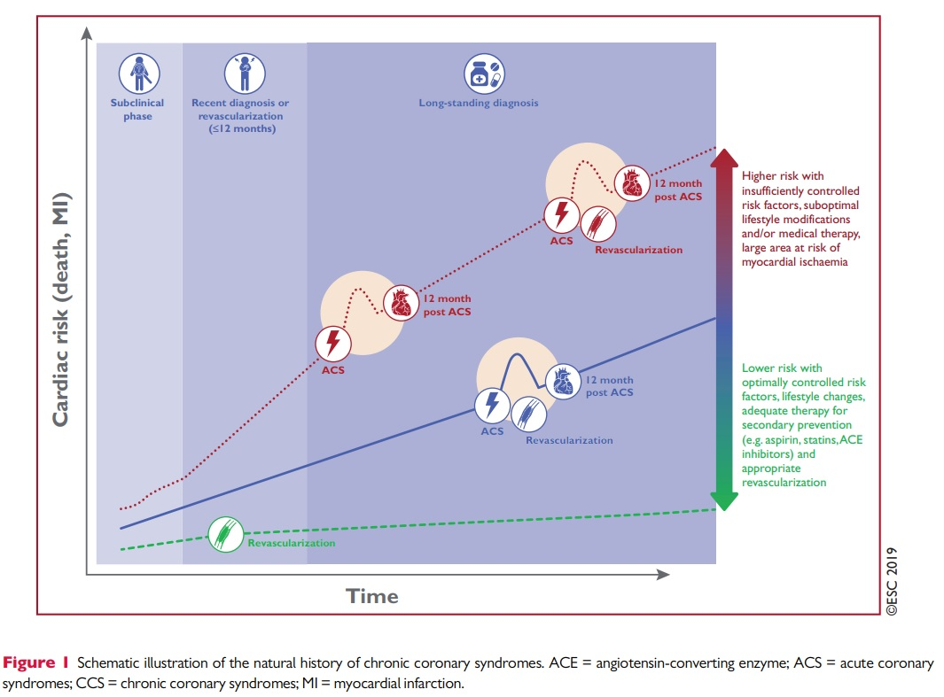
Natural history
long, stable periods
episodes of ACS due to
acute atherothrombotic event caused by –plaque rupture or erosion²
Chronic coronary syndrome→ revascularized → good prognosis
Chronic coronary syndrome—> ACS→ revascularization→ better prognosis
Chronic coronary syndrome→ ACS→ not revascularized—worse prognosis

Slide 10
Angina associated with increased mortality than general population
Mortality →
without treatment –4% per year
with treatment 1-3% per year
major ischemic event—1-2% per year
REACH (Reduction of atherosclerosis for continued health) registry—
1 yr CV death—1.9%
All cause mortality 2.9%
CV death, MI or stroke—4.5%

Slide 11
Features of high risk for adverse events in SIHD→
Older age
Males
Diabetes mellitus
Previous MI
Symptoms typical of angina
Severity of angina
Presence of dysponea

Slide 12
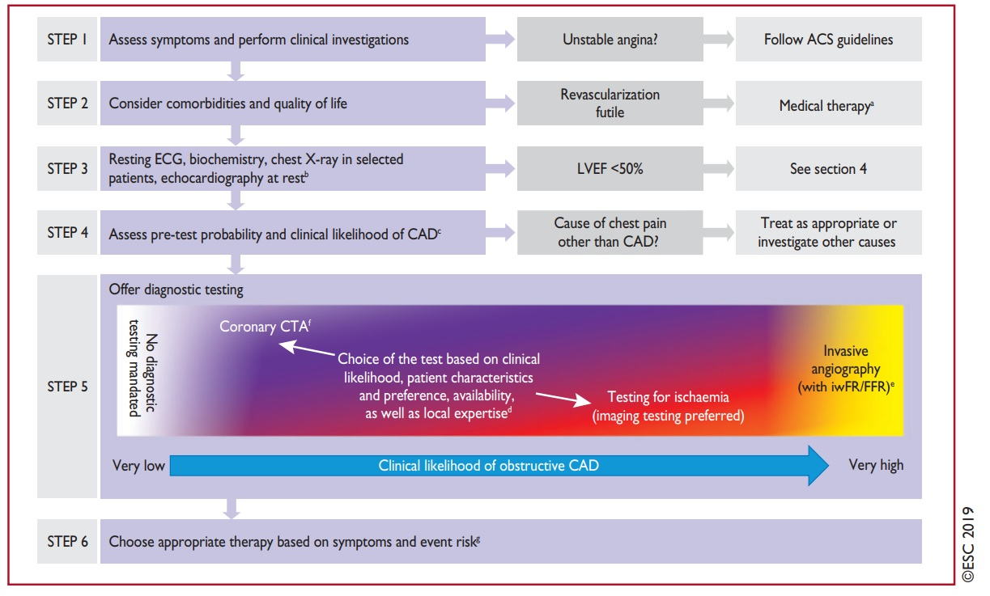

Slide 13
Clinical features
Angina – most common symptom
Angina equivalents—mid epigastric discomfort, dysponea, effort intolerance, excessive fatigue
is associated with physical limitation and worse quality of life

Slide 14
Diamond and Forrester classification
Characteristics | Classification
Precipitated by exertion or emotion Relived by rest / sublingual NTG Character—substernal discomfort or heaviness or pressure or burning—located in central chest radiating to left arm, jaw, neck or back
type | Criteria
typical | All 3
atypical | 2 of 3
Non cardiac | <2

Slide 15
Canadian cardiology society functional classification of angina
Class | Activities
1 | Ordinary activity doesnot produce angina –walking/ climbing stairs Angina occurs at strenuous exercise or rapid or prolonged exertion at work or recreation
2 | Slight limitation of ordinary activity including: Walking stairs rapidly Walking uphill Stair climbing after meals Angina occurs : Walking >2 blocks(level ground) or climbing one flight of stairs at normal pace and normal conditions
3 | Marked limitation of ordinary physical activity Walking less than 1 block at level ground and climbing <1 flight of stairs in normal condition
4 | Inability to carry out any physical activity without discomfort Angina occurs with minimal activity or may be present at rest

Slide 16
Asymptomatic or silent myocardial ischemia
when myocardial ischemia occurs in absence of angina or angina equivalent
It has an unfavourable prognosis
Detected by continuous ecg monitoring
Pathophysiology controversial
Lack of pain sensation due to sensory afferent nerve abnormality
Ischemic preconditioning—repeated short episodes of ischemia protect myocardium against a subsequent ischemic insult
Seen in →Diabetics, Previous MI,Elderly, CKD

Slide 17
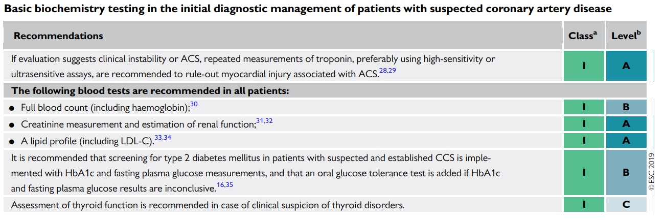

Slide 18
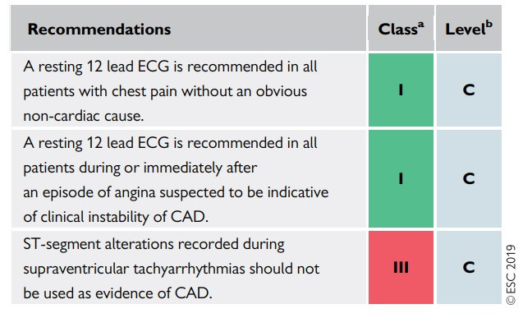
Resting ECG
50% have normal—implies normal resting LV function and favourable prognosis
MC abnormality—nonspecific ST-T wave changes with or without Q wave
ST-T changes during rest—poor prognosis
Conduction abnormality—LBBB (impaired LV function, multivessel CAD, poor prognosis), left anterior hemiblock
LV hypertrophy—worse prognosis—implies underlying HTN, AS, HCM, previous MI with remodelling
VPC –very low sensitivity and specificity for detecting CAD

Slide 19
During angina—50% have abnormal findings—
ST depression (MC)
ST elevation
Pseudo-normalization—normalization of previous ST wave depression / T inversion

Slide 20
Resting echocardiography
European society of cardiology – all patients with SIHD-class 1
American College of cardiology / American Heart Association—class 1 recommendations→
History of MI
ST-T wave changes
Conduction abnormalities
Q wave in ECG
Increased BNP
Uses→
Exclude alternate cause of angina
Regional wall motion abnormality
LVEF—risk stratification
Diastolic function

Slide 21
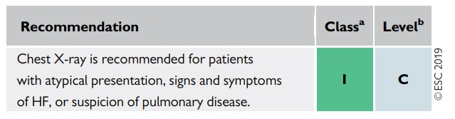
Chest x-ray
Cardiomegaly
Severe CAD—with previous MI
2. Pre-existing hypertension
3. Concomitant valvular heart disease or cardiomyopathy

Slide 22
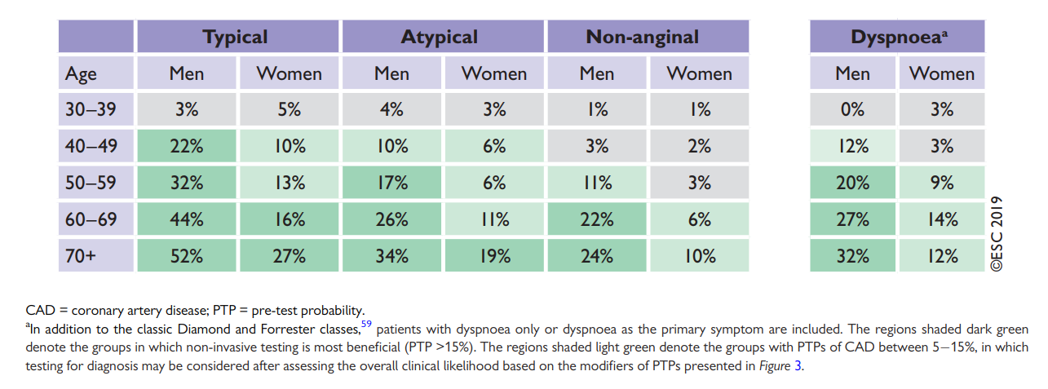
Pretest probability

Slide 23
If pretest probability is low —
negative test is confirmatory
positive stress test more likely to be false positive
High pretest probability –
positive result is confirmatory
negative stress test is more likely to be false negative
Stress test is more meaning full in intermediate pretest probability

Slide 24
Pre test probability→
</= 5%-- diagnostic testing done only for compelling reasons
<15%-- annual risk for cardiovascular death or MI <1%

Slide 25
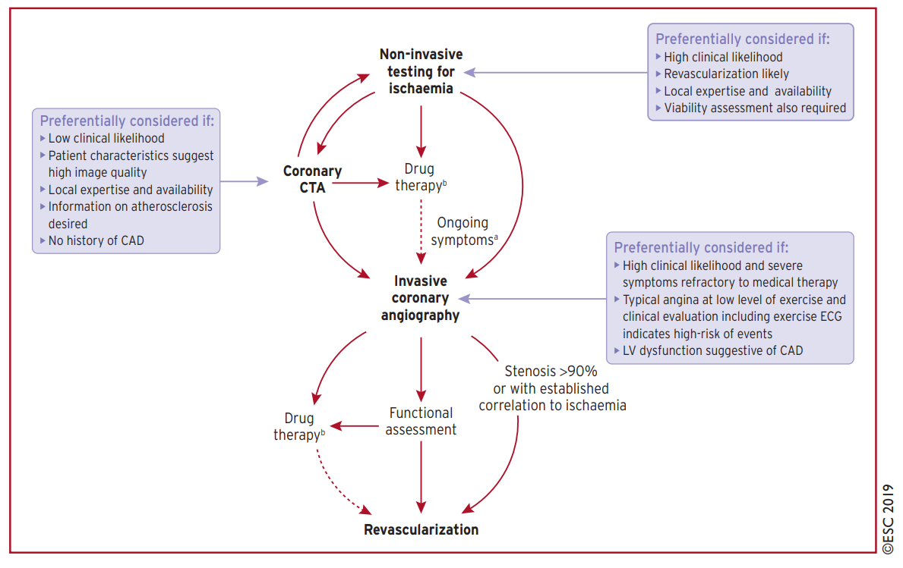

Slide 26
Exercise electrocardiogram
Helpful in patient with chest pain with mod probability of CAD, resting ECG normal, who can achieve an adequate workload
Diagnostic value is limited in high and low pre test probability—gives information about→
Degree of functional limitation
Patient with high pretest probability – severity of ischemia and prognosis
Parameters for interpretation of TMT→
Exercise capacity—METS
Clinical, hemodynamic and electrocardiographic responses

Slide 27
Exercise ECG in asymptomatic patient indicated—
High cardiac risk who is planning to begin vigorous exercise
High risk profession—airline piolets
Evidence of extensive atherosclerotic disease in another non invasive testing—cardiac CT
Risk stratification by exercise ECG—
Age adjusted METS
ST depression
Abnormal HR and BP response

Slide 28
High risk stress test result—high likelihood of CAD→ undergo CAG
Negative exercise test results—excellent prognosis—symptoms usually wont improve by revascularization
ST depression <1mm with high work load (>9 minutes on bruce protocol)—donot warrant CAG before an adequate trial of medical therapy

Slide 29
Effect of antianginals on exercise ECG→ reduce sensitivity of exercise ECG as a screening tool
If aim of test is to screen for ischemia—anti anginals need to be discontinued
If aim of test is for risk stratification in a patient with known CAD—no need to discontinue anti anginals
Long acting beta blockers—to be stopped 2-3 days before exercise testing
Long acting nitrates, calcium channel blockers, short acting beta blockers to be stopped on day on testing

Slide 30
Myocardial perfusion imaging
Utilization of IV admistered radioopaque pharmaceutical to identify the distribution of blood flow in the myocardium and it is imaged by gamma camera
Detects—
Perfusion
Uptake
Metabolism

Slide 31
Indications for myocardial perfusion imaging→
Diagnosis of CAD—
Presence
Location and severity of CAD in case of suspected or known CAD
2. Assessment of the impact of coronary stenosis found on anatomical imaging on regional perfusion
3. Differentiate between ischemic myocardium from scar
4. Risk assessment and stratification
5. Monitor treatment effect

Slide 32
Stress myocardial perfusion imaging
Stress myocardial perfusion imaging with simultaneous ECG recording—superior to exercise ECG alone—in detecting→
CAD
Determining the magnitude of ischemic and infarcted myocardium
Use of stress myocardial perfusion imaging→
Patients with abnormal resting ECG
In whom ST segment response couldnot be assessed—LV hypertrophy, patients on digitalis
Pharmacological agents used for stress perfusion imaging in patients who cannot do exercise→Adenosine, Regadenoson, Dobutamine

Slide 33
FDG PET
In fasting state, heart predominantly uses free fatty acid as a source of fuel
During ischemia—myocyte switches to glucose as its predominant source of energy

Slide 34
PET ….. stunned v/s hibernating v/s scar
 | perfusion | metabolism | Recovery on revascularization
Stunned myocardium | normal | Decreased/ normal | Yes
Hibernating myocardium | decreased | Increased relative to perfusion | Yes
Transmural infarction | decreased | decreased | No

Slide 35
Advantages of PET→
Less radiation burden
Significantly higher sensitivity than Tl201 rest redistribution imaging
Spatial resolution superior to SPECT but inferior to MRI
Well established attenuation correction
Metaanalysis sugest sensitivity of 90% and specificity of 60-70%
Limitations
Not suitable for use in acute ischemia
Influenced by serum glucose, FFA and insulin levels
Principle of relativity

Slide 36
Stress echocardiography
Performed with exercise or pharmacologic stress with dobutamine
Identify regional wall motion abnormality with stress
Helps in localizing and quantifying ischemic myocardium
Similar accuracy as stress MPI and superior to exercise electrocardiography
Use of myocardial contrast agents, 3D imaging and strain rate echocardiography—improves the diagnostic accuracy

Slide 37
Computed tomography
Coronary artery calcification CAC—detected with a rapid noncontrast CT that utilizes only low doses of ionizing radiation
Useful in screening asymptomatic patients at intermediate risk for CAD
2. Coronary CT angiography— angiography of the coronary arterial tree and quantification of ventricular function
Symptomatic patients who donot have history of CAD
Significance of CT angiography→To exclude significant CAD with a high negative predictive value
Comparison with stress testing→ PROMISE trial (Prospective multicenter imaging study for evaluation of chest pain)
More chance likely to have non obstructive CAD
SCOT HEART trial—Scottish computed tomography of the Heart—detection of obstructive CAD—increased secondary prevention therapies—less event rates

Slide 38
Limitation utility in→
Presence of tachycardia
Heavy coronary calcium
In regions of previous coronary stents

Slide 39
Cardiac MRI
To assess myocardial viability
Advantages of Stress Cardiac MRI over SPECT→
Characterization of LV function
Delineation of patterns of myocardial diease—help to differentiate ischemic v/s non ischemic disease

Slide 40
High risk (>3% annual risk for death or myocardial infarction) Severe resting left ventricular dysfunction (LVEF <35%) not readily explained by non coronary causes Resting perfusion abnormalities involving >10% of the myocardium without previous known MI High risk stress finding on the ECG, including→ >/= 2 mm ST segment depression at low workload or persisting into recovery Exercise induced ST segment elevation Exercise induced VT/VF 4. Severe stress induced LV dysfunction (Peak exercise LVEF<45% or drop in LVEF with stress >10%) 5. Stress induced perfusion abnormalities involving >/= 10% of the myocardium or stress segmental scores indicating multiple vascular territories with abnormalities 6. Stress induced LV dilation 7. Inducible wall motion abnormality ( involving >2 segments or 2 coronary beds) 8. Wall motion abnormality developing at a low dose of dobutamine (</= 10 mg/kg/min) or at a low heart rate (<120/min) 9. Multivessel obstructive CAD (>/= 70% stenosis) or left main stenosis(>/= 50% stenosis) on CCTA

Slide 41
Life style recommendations
Smoking cessation—both active and passive
Healthy diet—diet high in vegetables, fruits and whole grains
Limit saturated fatty acid <10% of total calorie intake
Dietary fiber >10gm/day
3. Limit alcohol to <100gm /week or 15gm/day
4. Physical activity 30-60mins moderate physical activity in most of days (5-7 times a week)
5. Healthy weight—BMI<25kg/m2
6. Drug compliance
7. Cardiac rehabilitation – in high risk individuals with CCS
Reduces cardiovascular mortality by 26% and risk of hospital admission by 18%-- at end of 12months when compared with usual care
8. Treatment of associated depression

Slide 42
reduce mortality or morbidity
aspirin
statins
angiotensin converting enzyme inhibitors
P2Y12 inhibitors
Ezetimibe
PCSK9 inhibitors
High dose eicosapentaenoic acid
Colchicine
Improve symptoms and exercise performance –effect on survival not demonstrated
Nitrates
Beta blockers
Calcium antagonists
Ranolazine
SIHD with LV dysfunction after MI—reduce mortality and the risk for repeat MI→
ACE inhibitors
Beta blockers

Slide 43
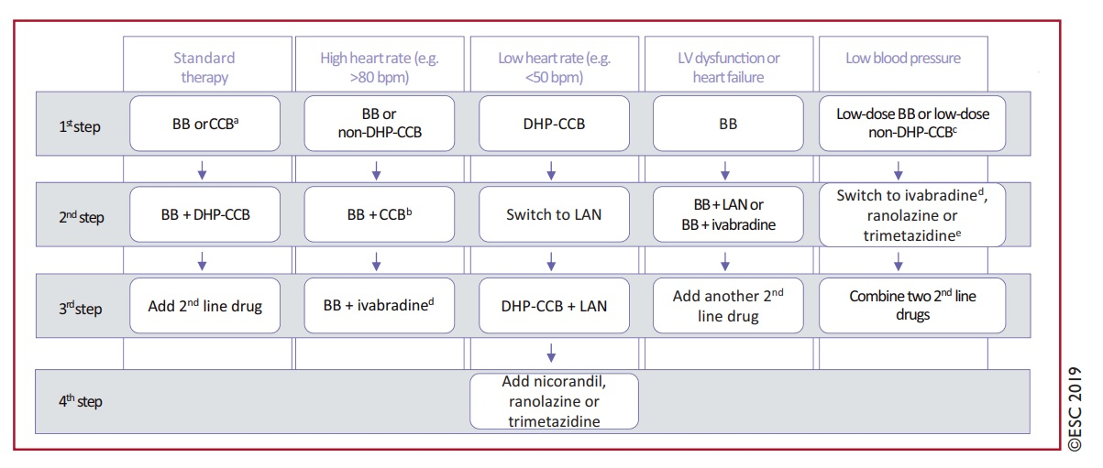

Slide 44
Nitrates
Nitroglycerine and isosorbide dinitrate—nitric oxide donors→ activate soluble guanylyl cyclase in vascular smooth muscle cells → increase intracellular cyclic guanosine monophosphate→ vasodilation
Predominantly venodilator with arterial dilator action

Slide 45
Beneficial→ Decreased myocardial oxygen demand— Venodilation of capacitance vessels to decrease preload—decrease LV wall stress and myocardial oxygen demand decreased ventricular volume, decreased arterial pressure, decreased ejection time Relief of coronary vasospasm—vasodilation of epicardial coronary arteries Increased collateral blood flow—increased perfusion to ischemic myocardium Decreased left ventricular diastolic pressure—improved subendocardial perfusion
Potential deleterious effects→ Increased myocardial oxygen demand—reflex tachycardia, reflex increase in contractility Decreased coronary perfusion—decreased diastolic perfusion time due to tachycardia

Slide 46
Donot affect survival or decrease cardiovascular death rates in CAD patients
Tachyphylaxis—overcome by nitrate free interval of 8-12hrs or longer drug holidays (2-3 days off)
Coadministration with Phosphodiesterase -5 inhibtiors—sildenafil, tadalafil or vardenafil—life threatening hypotension

Slide 47
Betablockers
Decreased oxygen demand→
Decreased heart rate
Decreased wall stress—decreased afterload, decreased heart rate
Decreased contractility
Decreased Oxygen usage
Increased oxygen supply—
Increased diastolic perfusion
Less exercise vasoconstriction

Slide 48
Decreased demand and increased supply→ oxygen deficit decreases→ decreased anaerobic metabolism
Avoids negative remodelling
Most effective drug in decreasing oxygen demand and increasing oxygen supply—cardio selective beta blockers
Improved short- and long-term survival rate in post MI patients
Recommended Beta blocker in patients with CAD and heart failure→ carvedilol, long acting metoprolol, bisoprolol

Slide 49
Data to support cardiovascular event in patients with CAD without MI is limited
REACH registry (Reduction of atherothrombosis for continued health) – CAD without MI—no significant difference with beta blockers v/s no beta blockers at a median 3.7yrs of follow up
primary outcomes (CV death, MI or stroke) HR 0.92
secondary outcomes—primary outcome + hospitalization—HR 1.14
tertiary outcomes—hospitalization—HR 1.17
CathPCI registry – stable angina (without prior MI, systolic heart failure, EF <40%) undergoing elective PCI—beta blocker use at discharge was not associated with lower CV events at 3yr follow up, but was associated with a higher rate of the composite of death, MI, stroke and heart failure HR 1.04
In low risk patients (without AF or reduced EF)—beta blockers recommended only for up to 3yrs

Slide 50
target heart rate-->
heart rate </= 60 at rest, </= 75/min at exertion
or </= 75% of heart rate at which angina occurs
adding beta blockers to other anti anginals –more effective in controlling anginal symptoms than does monotherapy with either agent alone

Slide 51
Calcium channel blockers
Inhibit entrance of Calcium into cardiac smooth muscle cells of the coronaries and systemic arterial beds
vasodilation of epicardial coronaries → improve Coronary blood flow—relive vasospastic and exertional angina
decreased PVR, decrease mean arterial Bp→ decrease LV afterload
negative inotropic effect
Negative inotropic effect -can worsen LVEF in already decreased LV function
In patients with normal LVEF—CCBs will increase cardiac contractility as reflex to decreased systemic vascular resistance
Antianginal effect is similar to Beta blockers—but as a monotherapy in CCS benefit not demonstrated convincingly

Slide 52
Contraindications of calcium channel blockers→
Cardiogenic shock
Recent MI
Heart failure
AV block
Indication of CCB—as a add on after beta blockers, nitrates, ACE inhibitors
Useful in prinzmetal angina in conjunction with nitrates

Slide 53
Ranolazine
Piperazine derivative ---Selective inhibitor of late sodium influx in myocytes→
decreased myocardial contractility
Improves exercise tolerance in patients with CAD
No effect on heart rate and BP
Metabolic modulation—shift myocardial substrate uptake from fatty acid to glucose
Reduction in calcium overload in ischemic myocytes via inhibition of the late inward sodium channel

Slide 54
Effect in myocyte→
Preserves tissue level ATP
Improves myocardial contractile function
Reduces the extend of irreversible myocardial injury
Coexistant anti arrhythmic action –due to sodium channel blockade

Slide 55
Adverse effect—QT prolongation
Dose 500-1000 1-0-1
Contraindications→
Cirrhosis liver
QTc prolongation and Qt prolonging drugs—non dihydropyridine CCBs, quinolones, azole
Dose modification required in kidney disease

Slide 56
CARISA—Combination assessment of Ranolazine in stable angina —CCB (amlodipine, diltiazem) and betablocker (atenolol) + ranolazine 750-1000mg BD—significantly increased time to onset of angina and exercise performance compared with placebo
Also decreased frequency of angina
MERLIN-TIMI 36—placebo v/s ranolazine –in ACS NSTEMI
Indication→ reserve drug for persistent symptoms despite maximal medical therapy or patients unable to tolerate other antianginal therapies because of adverse effects

Slide 57
Nicorandil
Nitrate derivative of nicotinamide
IONA – impact Of Nicorandil on Angina trial– compared to placebo—decreased—
Composite of coronary heart disease death + Non fatal MI + Unplanned hospital admission for suspected ACS syndrome
No effect on death from ischemic heart disease or non fatal MI
Recommendation – second line drug in patients with CCS

Slide 58
Trimetazidine
Improved exercise induce ischemia symptoms when added to Beta blocker
Dose 35mg BD
Contraindication– movement disorders—
Parkinsonism
Restless leg syndrome

Slide 59
Ivabradine
MOA—inhibit funny current channel
Indications→ heart failure with HR >70 in sinus rhythm in patient with LVEF < 35%
T1/2—6hrs
Adverse effects—bradycardia, AF, visual brightness, hypertension, QT prolongation
Dosing→5-2.5mg BD max 7.5mg BD

Slide 60
Angiotensin converting enzyme inhibitors
Long term ACE inhibition – reduces cardiovascular death, recurrent MI, stroke—in intermediate and high risk patients with CCS
HOPE trial—Heart outcomes prevention evaluation—Ramipril 10mg/day v/s placebo in – patients with CAD, stroke, Peripheral vascular disease or diabetes + one other cardiovascular risk factor
rampril resulted in significant reduction in the rate of death from cardiovascular causes, MI and stroke over 5yrs 14% v/s 17.8% HR 0.78
It also reduced incidence of diabetes
EUROPA trial—European trial on Reduction of cardiac events with perindopril in Stable coronary artery disease – patient with CCS and relatively lower risk profiles—perindopril reduced cardiovascular disease outcomes²

Slide 61
PEACE trial—prevention of events with Angiotensin converting enzyme inhibitor therapy—patient with normal LV function, optimal lipid profiles and prior revascularization—benefit was not clear²
Metaanalysis showed ACE inhibitors reduced Cardiovascular outcomes in patients with CAD without heart failure—when compared with placebo only not with other medications²

Slide 62
Role in SIHD→
Reduces risk of future ischemic event
Reduction in LVH, vascular hypertrophy, plaque rupture and thrombosis
Favourable influence on myocardial oxygen supply demand relationships an coronary endothelial vasomotor function
ARBs as effective alternatives to ACE inhibitors

Slide 63
Indications→
Class 1—all CAD with LV dysfunction, hypertension, diabetes, CKD²
Class 2a—in CAD and other vascular disease²

Slide 64
Antiplatelets
platelet aggregation is an important step in the pathogenesis of MI following plaque rupture
Aspirin—irreversibly inhibiting cyclooxygenase-1 and decreased synthesis of platelet thromboxane A2
Aspirin v/s placebo—decrease major vascular events without a significant increase in the risk of hemorrhagic stroke
MI- 4.3% v/s 5.3% per year RR-0.69
Stroke—2.08% v/s 2.54% per year RR 0.81
Dose of aspirin recommended for secondary prevention of MI in patients with CCS—AHA/ACC class 1 recommendation
75-162mg/day

Slide 65
Clopidogrel—thienopyridine derivative—inhibit platelet aggregation by—irreversible inhibition of ADP P2Y12 receptor
Used in combination with aspirin
Effectiveness of clopidogrel depends on production of active metabolite by cytochrome P450 system (CYP2C19) –varients of CYP2C19—associated with decreased action of clopidogrel –found in 30% of patients
CAPRIE trail—Clopidogrel versus aspirin in patients at risk of ischemic events—clopidogrel resulted in modest relative reduction in risk for vascular death, ischemic stroke or MI.
CHARISMA trial (Clopidogrel for high atherothrombotic risk and ischemic stabilization management and avoidance trail)—addition of clopidogrel to aspirin resulted in modest relative reduction in the risk for vascular death, ischemic stroke or MI over a period of 2 yrs.

Slide 66
Ticagrelor -P2Y12 inhibitor with strong antiplatelet efficacy with reduced inter individual variability—superior to clopidogrel in ACS
Adding ticagrelor to aspirin – reduced risk of ischemic vascular events in patients with SIHD at a cost of increased risk of bleeding—patients with prior ACS or without prior ACS
Dose of 60mg BD offered similar efficacy with less bleeding than 90mg BD—after 1 yr of ACS

Slide 67
Prevention of Cardiovascular events in patients with prior heart attack using ticagrelor compared to placebo on a background of Aspirin Thrombolysis in Myocardial infarction 54 (PEGASUS TIMI 54)—21612 post MI patients 1-3yrs after MI into—Ticagrelor 90mg BD v/s ticagrelor 60mg BD v/s Placebo, in addition to aspirin—follow up 33 months
Primary efficacy end point—composite of cardiovascular death, myocardial infarction or stroke—7.85% v/s 7.77% v/s 9.04%
Major bleeding—2.60% v/s 2.3% v/s 1.06%
Intracranial hemorrhage or fatal bleeding—0.63% v/s 0.71% v/s 0.6%

Slide 68
Prasugrel - P2Y12 inhibitor with strong antiplatelet efficacy with reduced inter individual variability—superior to clopidogrel in ACS
Not Preferred in patients with prior stroke or TIA
Avoided in patients of age >75 or body weight <60kg—because of lack of net clinical benefit

Slide 69
Vorapaxar
Protease activated receptor -1 antagonist (PAR-1 antagonist)
Thrombin receptor antagonist in secondary prevention of atherothrombotic ischemic events-Thrombolysis in Myocardial infarction 50 trial—2.5mg OD
Increased risk of bleeding
Use limited to CAD + concomitant PAD

Slide 70
Dual antiplatelet therapy (DAPT) study –aspirin v/s ASPIRIN + clopidogrel or prasugrel after DES for 12 months to an additional 18 months—significantly reduced the risk of stent thrombosis and major adverse cardiovascular and cerebrovascular events but was associated with an increased risk of bleeding in DAPT arm
DAPT v/s Aspirin alone→
Stent thrombosis –0.4% v/s 1.4% Hazard ratio 0.29
Major adverse cardiovascular and cerebrovascular events 4.3% v/s 5.9% Hazard ration 0.71
Myocardial infarction-2.1 v/s 4.1 hazard ration 0.47
Death from any cause 2.0 v/s 1.5% hazard ratio 1.36
Moderate to severe bleeding—2.5 v/s 1.6

Slide 71
TWILIGHT trail—ticagrelor with aspirin or alone in high risk patients after coronary intervention trial—7119 patients 3 months DAPT—aspirin + ticagrelor v/s Placebo + ticagrelor –ticagrelor monotherapy decreased bleeding without increase in ischemic endpoints
Metaanlysis by Kuno T, Ueyama H, Takagi H, Banglore S—
Short term DAPT (</= 6months) f/b Aspirin or P2y12 inhibitor v/s Long term DAPT >/= 12 months—decreased risk of bleeding without increasing ischemic outcomes. No significant difference between aspirin and P2Y12
Some results favoured aspirin monotherapy to reduce risk of bleeding and P2Y12 monotherapy to decrease risk of stent thrombosis

Slide 72
ACC/AHA recommendation→
6months DAPT after PCI with DES—if high risk of bleeding 3months
1 month of DAPT after PCI with BMS
Newer approach→
1 month DAPT
Use of P2Y12 inhibitor as monotherapy instead of aspirin

Slide 73
Protease activated receptor -1 antagonist (PAR-1 antagonist) Vorapaxar –
Thrombin receptor antagonist in secondary prevention of atherothrombotic ischemic events-Thrombolysis in Myocardial infarction 50 trial—2.5mg OD

Slide 74
Anticoagulation therapy
Anticoagulation inhibit thrombin formation and consequently reduces risk of arterial thrombosis
Without indication of Oral anticoagulation
COMPASS trial—Cardiovascular outcomes for people using anticoagulation strategies trial
Rivaroxaban 2.5 BD + aspirin v/s aspirin alone—
Better cardiovascular outcomes—reduced composite of cardiovascular death, stroke, MI—4.1% v/s 5.4% HR 0.76
More major bleeding events 3.1% v/s 1.9% HR 1.70

Slide 75
With indication for oral anticoagulation
Triple therapy—aspirin + P2Y12 + oral anticoagulation—associated with increased risk of bleeding

Slide 76
OAC + P2Y12 v/s triple therapy→ reduction in bleeding with no increase in ischemic outcomes
Bleeding risk—odds ratio 0.58 for VKA, NOAC 0.49
MACE—VKA 0.96, NOAC-1.02
Prefer NOAC over VKA if no contraindications
SAPT—Prefer P2Y12 over aspirin
Preferred P2Y12—clopidogrel, ticagrelor may be considered in patients with high ischemic / thrombotic risk and low bleeding risk
Avoid prasugrel
SAPT + OAC after 12 months—only in selected patients at high ischemic / thrombotic and low bleeding risks

Slide 77
High bleeding risk
Age >75
Use of oral anticoagulation
End stage renal disease GFR<30
Hemoglobin <11
Spontaneous bleeding requiring hospitalization or transfusion in past 6 months
Thrombocytopenia <1lakh
Chronic bleeding diasthesis
Liver cirrhosis with portal hypertension
Active malignancy excluding non melanoma skin cancer in past 12 months
Previous spontaneous ICH, previous traumatic ICH in past 12 months, presence of AV malformation in brain, moderate to severe ischemic stroke in past 6 months
Non deferrable major surgery on DAPT
Recent major surgery or major trauma within 30days before PCI

Slide 78
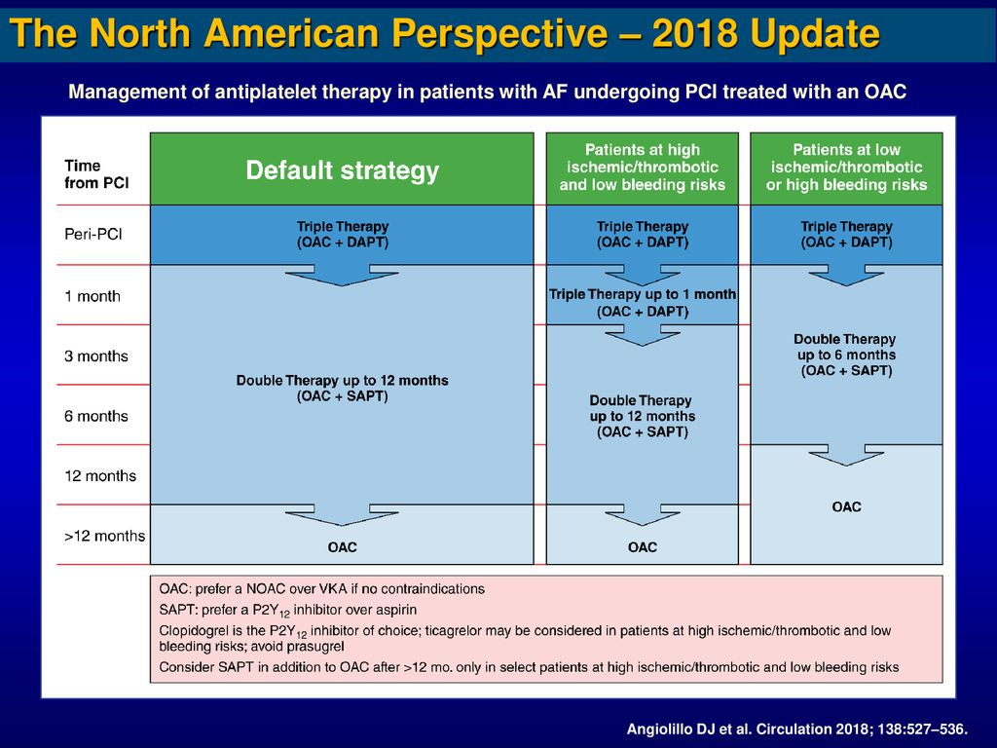

Slide 79
Lipid lowering therapy
Patients with established CAD—lipid lowering therapy irrespective of LDL-C levels
AHA guidelines—
high intensity statin (rosuvastatin 20-40/day, atorvastatin 40-80/day) in patients age <75
moderate intensity statin (rosuvastatin 10-20/day, atorvastatin 20-40/day) in patients >75yrs
2019 ESC guidelines→
LDL-c lowering by 50% from baseline and to <55mg/dL
LDL-c<40mg/dL—patient who had a second vascular event

Slide 80
For each 40mg/dL reduction of LDL-c→
10% reduction in all cause mortality
20% reduction in coronary mortality

Slide 81
Ezetimibe
Inhibit the absorbtion of cholesterol by the small intestine
IMPROVE IT—improved reduction of outcomes:Vytorin Efficacy International Trial –Simavastatin (40mg OD) + Ezetimibe (10mg OD) v/s Simvastatin 40mg OD—incremental lowering of LDL-C levels—reduced cardiovascular outcomes (HR 0.936)

Slide 82
PCSK 9 Inhibitors
Proprotein convertase subtilisin kexin type 9 (PCSK9)—degrades hepatic LDL receptors and reduces LDL-C by as much as 60%-- alirocumab and evolocumab—improved cardiovascular outcomes
Fourier trial— evolocumab v/s placebo in CCS with LDL-C 70mg/dL or higher who were receiving statin therapy
evolocumab reduced LDL-C—from 92mg/dl to 30mg/dl—reduced cardiovascular outcomes--9.8% v/s 11.3% (HR 0.85)
ADA/ACC 2018 recommendations—class 2a—add PCSK9 inhibitor in patients at very high risk of atherosclerotic cardiovascular disease on clinically judged maximal LDL-C lowering therapy and LDL C >/= 70 or non HDL C >100mg/dL

Slide 83
Vaccination
Annual influenza vaccine—reduced risk of major adverse cardiovascular events—
Recent ACS 10.25%v/s 23.1% RR 0.45
Stable CAD 6.9% v/s 7.4% RR 0.94
Class 1 recommendation for CCS
Pneumococcal vaccine—especially in 65yrs and older

Slide 84
Revascularization in SIHD

Slide 85
ESC 2019 recommendation
CCS with Heart failure --Angina persisting despite of treatment with antianginal drugs – Class 1a
Mild or no symptoms on OMT– non invasive risk stratification showed high risk and whom revascularisation is considered for improvement of prognosis—ICA with FFR—class Ic
Symptomatic patients with symptoms refractory to OMT or if belonging to high risk clinical profile—class 1c

Slide 86
Choice of revascularization—PCI v/s CABG→ depends on—
Coronary anatomy
LV systolic function
Systemic factors like diabetes
Patient values and preferences

Slide 87
CABG preferred if—
Extensive and complex CAD
LV systolic dysfunction
Diabetes

Slide 88
Indications for stenting in CCS→
LM main disease
Prox LAD significant disease
Refractory angina
CAG→
>90%-- revascularization
50-90%--FFR—drug therapy / revasularization

Slide 89
Revascularization v/s optimal medical therapy

Slide 90
COURAGE trial
1999-2004—symptomatic but stabilized angina (CCS angina class <4), one >/= 70% flow obstructing lesion in atleast one proximal epicardial coronary artery and objective evidence of myocardial ischemia—OMT v/s OMT + PCI
No significant difference in death or MI (19.0 v/s 18.5%, HR 0.95) or overall survival, survival free of MI and survival free of ACS at 4.6yrs
Freedom from angina and improved quality of life after PCI initial part of study—not significant difference after 24months
No significant long term mortality benefit at 6.2yrs 25% v/s 24% HR 1.03

Slide 91
BARI 2D-the bypass angioplasty revascularization investigation 2 diabetes trial
Type 2 DM patients with CAD—prompt revascularization (PCI v/s CABG within 4 weeks) + OMT v/s OMT alone
At end of 5yrs—rate of survival and freedom from major adverse cardiovascular events did not differ between medical and revascularization arm
Compared to the medical group, prompt revascularization at 3yr follow up period—
Lower rate of worsening angina 8% v/s 13%
New angina 37% v/s 51%
Subsequent coronary revascularization 18% v/s 33%
Higher rate of angina free status 66% v/s 58%

Slide 92
FAME 2 trial
with atleast one functionally significant coronary stenosis (FFR </= 0.80) to either FFR guided PCI + best available medical treatment v/s best available medical therapy alone
Composite end point of death, MI or urgent revascularization—4.3% v/s 12.7% HR 0.32
Primary endpoint was lower even at 5yr follow up

Slide 93
ISCHEMIA—international study of comparative health effectiveness with Medical and invasive approaches trial
Moderate -severe ischemia patients --- an initial invasive strategy (angiography and revascularization) + medical therapy v/s initial conservative therapy and angiography is medical therapy failed
CCTA—to rule out Left main disease or non obstructive CAD
At 3.2 yrs follow up—initial invasive strategy did not reduce the risk of ischemic cardiovascular events—composite death from cardiovascular causes, MI or hospitalization for unstable angina, heart failure or resuscitated cardiac arrest or death from any cause
Initial invasive therapy had higher primary outcome and MI in first 2 yrs due to periperocedural MI

Slide 94
After 2 yrs—primary outcomes and MI was higher in conservative management group
Initial conservative management decreased non procedural MI and hospitalization for unstable angina—increased procedural MI and hospitalization for heart failure
Angina related health status – greater improvement in invasive strategy group

Slide 95
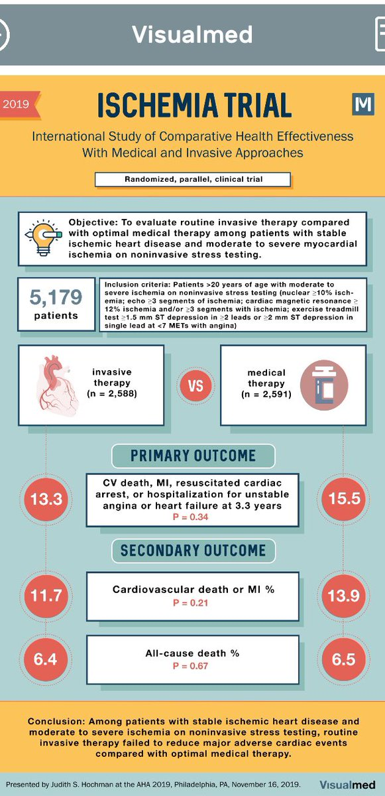

Slide 96
ISCHEMIA-CKD trial
eGFR<30 or on dialysis patients with moderate to severe ischemia—initial invasive (angiography and revascularization is feasible) and medical therapy v/s medical therapy alone and angiography if medical therapy failed
initial invasive strategy did not reduce the risk of the primary end point of death or non fatal MI
no substantial benefit with regard to angina related health status

Slide 97
Meta analysis
routine revascularization was associated with
reduced non procedural MI
reduced unstable angina
greater freedom from angina
but at the expense of increased procedural MI with no difference in survival

Slide 98
STICH trial—surgical treatment for ischemic heart failure (in ischemic cardiomyopathy EF<35% )
medical therapy alone v/s medical therapy + CABG
4.7yrs follow up→ medical therapy + CABG
similar all cause death, HR 0.84
lower cardiovascular death, HR 0.81
lower composite of death or hospitalization for cardiovascular causes, HR 0.74
9.8yrs follow up→ medical therapy + CABG
reduced all cause death, HR 0.84
cardiovascular death HR 0.79
composite of death or hospitalization for cardiovascular causes

Slide 99
percutaneous coronary intervention v/s coronary artery bypass graft surgery

Slide 100
BARI-1—Bypass angioplasty revascularization investigation-1
Balloon angioplasty v/s CABG surgery in patients with multivessel CAD and angina—followed up for >5yrs
no long term survival advantage was seen for CABG v/s PTCA
patients with diabetes CABG using left internal thoracic artery for LAD bypass—improved survival

Slide 101
SYNTAX –the Synergy between PCI with Taxus and Cardiac surgery trail
non inferiority between multivessel PCI (with a first generation paclitaxel-eluting stent) and CABG surgery for patients with multivessel CAD for the primary composite end point—death from any cause, stroke, MI or repeat revascularization during 12months following treatment
surgical revascularization—lower rate of combined primary end point—mainly due to reduced need for revascularization
no difference between treatment groups for combined end point of death from any cause, stroke, MI
surgery had increased risk of periprocedural stroke

Slide 102
SYNTAX score—score for objective evaluation of coronary disease severity and likelihood of revascularization success
right, left or codominant circulation
number of atherosclerotic lesions
number of artery segments involved per atherosclerotic lesion
4) total occlusion—
number of segments involved
age of total occlusion
presence of a blunt stump
presence of bridging collateral
antegrade v/s retrograde filling of the first segment beyond the occlusion
side branch involvement

Slide 103
5) trifurcation lesion—number of vessel segments diseased
6) bifurcation lesion—angulation between the distal main vessel and the side branch <70 degree
7) presence of an aorto ostial atherosclerotic lesion
8) presence of severe vessel tortuosity at lesion site
9) atherosclerotic lesion length >20mm
10) presence of heavily calcified plaque
11) presence of thrombus
12 ) presence of diffuse or small vessel disease

Slide 104
high >33 and intermediate 23-32 SYNTAX scores—lower rates of MACCE with surgery compared with PCI upto 5yrs
high SYNTAX score 26.8% surgery v/s 44% PCI
intermediate SYNTAX score—25.8% Surgery v/s 36% PCI
low SYNTAX score—event rates were similar

Slide 105
PCI non inferior to CABG for Left Main CAD—MACCE occurred in 31% CABG v/s 36.9% PCI P-0.12
CABG and PCI had same survival rate at end of 10yrs except in 3 vessel disease

Slide 106
Left main coronary artery disease
PRECOMBAT—The Premier of Randomized Comparison of Bypass Surgery versus Angiogram Trial—600 patients with LM at least 50% --PCI v/s CABG with a left internal mammary artery graft
no difference in the primary end point of all cause mortality, MI, stroke and ischemia driven target vessel revascularization between PCI and CABG at end of 5yrs
Target vessel revascularization was almost double in PCI group 11.4% v/s 5.5%
LM + TVD—results favoured bypass surgery
10yr follow up—no significant difference between PCI and CABG for MACE and all cause mortality

Slide 107
NOBLE trial—left main disease to PCI with biomatrix flex stent v/ CABG
At 5yr follow up—PCI was inferior to CABG for the primary endpoint but there was no difference in all cause mortality between the groups

Slide 108
EXCEL—Evaluation of Xience versus Coronary artery bypass surgery for effectiveness of left Main revascularization trial
LM disease with SYNTAX score <32 to PCI with everolimus eluting stent v/s CABG
3yr follow up—PCI non inferior to CABG for primary end point of death, MI or stroke
higher event rate with CABG for secondary end point of death, MI or storke at 30days
At 5yrs—PCI was associated with→
Similar rate of primary end point, cardiovascular death, MI
Lower rates of Cerebrovascular events
Higher rates of all cause death and ischemia driven revascularization

Slide 109
Meta analysis
Similar risk of all cause death HR 1.11, cardiovascular death, MI and stroke
Higher risk of repeat revasularization with PCI

Slide 110
Diabetes mellitus
Important predictors of outcome
major determinant of the optimal mode of revascularization
Issues with diabetes—
Greater extend of disease
Higher risk of other comorbidities like renal dysfunction, LV dysfunction
Higher chance of thrombosis
Higher rate of in stent restenosis and target vessel revascularization

Slide 111
FREEDOM trial
to address optimal revascularization strategy in patients with Diabetes and multivessel CAD—in absence of left main disease, prior CABG, prior stenting in 6months and current ST elevation MI—CABG v/s first generation DES
Primary composite end point of death, non fatal MI, non fatal stroke was lower in CABG group than in PCI group 18.7% v/s 26.6% -driven by decrease in MI, death but increase in stroke
Long term follow up—7.5yrs—all cause mortality was significantly higher in PCI-DES group

Slide 112
Meta analysis in PCI with second generation DES—
Long term mortality gap decreased to statistically non significant
Lower upfront risk of death and stroke in PCI group

Slide 113
Left ventricular systolic dysfunction
From analysis for 4616 patients with mutlivessel disease and severe LV dysfunction (EF35%) PCI with evrolimus eluting stent vs CABG
At median follow up 2.9yrs—
Similar risk of death HR 1.01
Increased risk of MI HR 2.16
Lower risk of stroke HR 0.57
Higher risk of repeat revascularization HR 2.54

Slide 114
Follow up
After initiation and titration of OMT—follow up every 4-6 months
General assessment—
Functional capacity
Response to treatment
Changes in quality of life
Any adverse effect of medications
FLP every 6-12months

Slide 115
Screen for—
Depression, social isolation
CKD
Peripheral vascular disease
Sexual dysfunction
Obstructive sleep apnoea

Slide 116
Refractory angina
Long lasting symptoms despite (> 3months) –due to established reversible ischemia in the presence of obstructive CAD—which cannot be controlled by
Escalating medical therapy with use of second and third line pharmacological agents
Bypass grafting or Stenting
Including PCI for Chronic total occlusion
Poor quality of life with recurrent hospitalization

Slide 117
Treatment options
External counterpulsation—class 2b
Coronary sinus constriction—class 2b
Neuromodulation

Slide 118
Enhanced external counterpulsation
compressed air induced positive pressure to the lower extremities
from lower legs to upper thigh
synchronized with the cardiac cycle (during early diastole)
increased retrograde aortic blood flow and increased coronary diastolic perfusion pressure

Slide 119
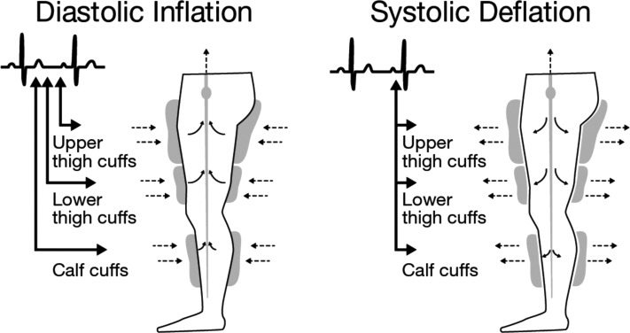

Slide 120
35hrs of treatment time
patients with severely limiting angina without a smoking history
RCT of EECP v/s OMT not available

Slide 121
Reduction in angina frequency
Nitrate use
Increased exercise tolerance
Improved quality of life

Slide 122
Contraindications
Aortic regurgitation
Recent revascularization
Severe hypertension

Slide 123
Coronary sinus constriction
Focal narrowing→ increases pressure in the coronary sinus potentially redistributing blood into ischemic myocardium
Device not approved in US
Notes:
Coronary sinus reducer for treatment of refractory angina trial

Slide 124
Spinal cord stimulation
Stimulation of C7-T1 of dorsal epidural space
alters neurovascular tone favourably, improves coronary blood flow, exerts anti ischemic effect
Spinal cord stimulation resulted –
lower 6month mortality
improvement in angina frequency and severity
Notes:
Approved method for neuromodulation

Slide 125
MCQs

Slide 126
Stress test is more useful in patients with –
Low pre test probability
High pre test probability
Intermediate pre test probability
In all patients

Slide 127
Contraindication of Ranolazine
Renal failure
Heart failure
Angina
Qt prolongation

Slide 128
According to ESC 2019 guidelines target LDL-c in a patient who had second vascular event—
<70
<100
<110
<40

Slide 129
In patient with high bleeding risk, how long triple therapy is recommended—
Peri PCI
Upto 1 month
Upto 6 months
Upto 1 yr

Slide 130
Conditions in which CABG preferred over PCI
Extensive and complex CAD
LV systolic dysfunction
Diabetes
All the above

Slide 131
Thank you

